Slide 1
Dayton / Chicago
Forecasting energy usage based on historical usage and weather data.

Slide 2

New Data Viz Team
Zachary Johnson
Matt Garber
Paul Cousin
Mary Kilmer

Slide 3
Core Message
Goal: Increase accuracy of on hand energy.
Can we use weather data to forecast the energy consumption?

Slide 4
Agenda
The Data
Data Viz
Machine Learning Model
Results from the Model

Slide 5
PJM

Slide 6
The Data
Kaggle
Hourly Energy Consumption
By power provider
CSV file
Energy Information Administration
Geographic data
Government Source
Shape File
Open Weather Map
Daily weather metrics
City level data
JSON file

Slide 7
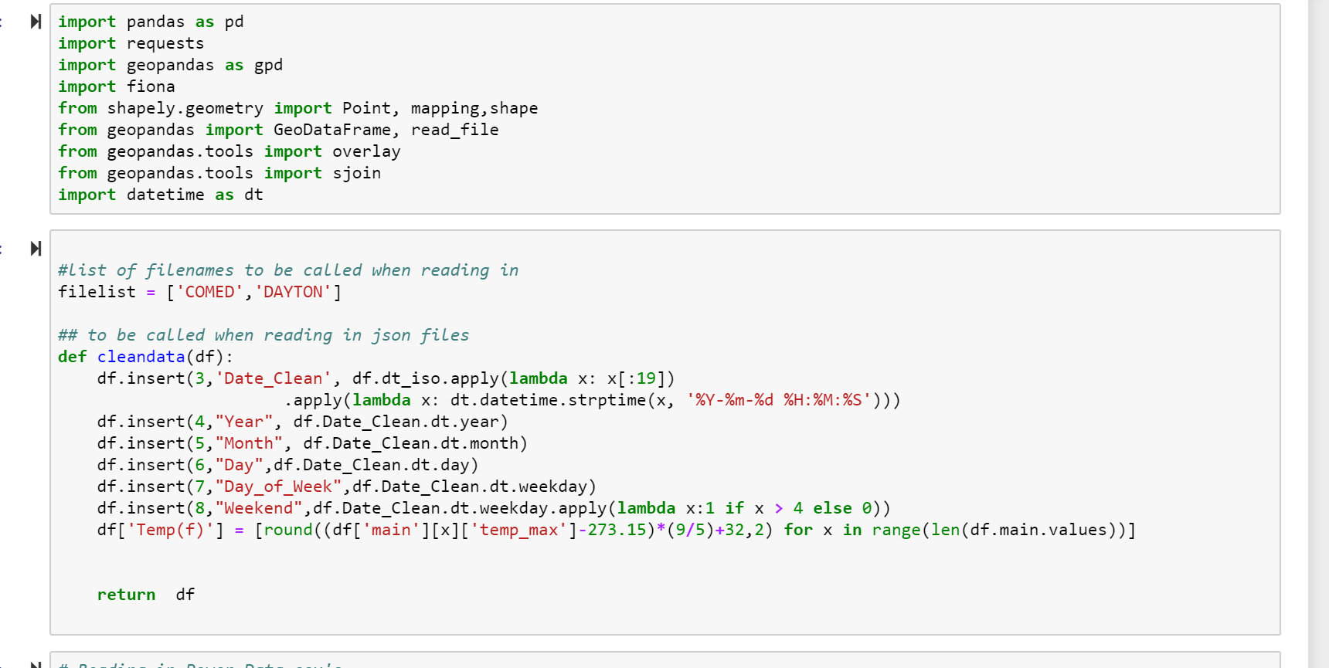
The Data

Slide 8
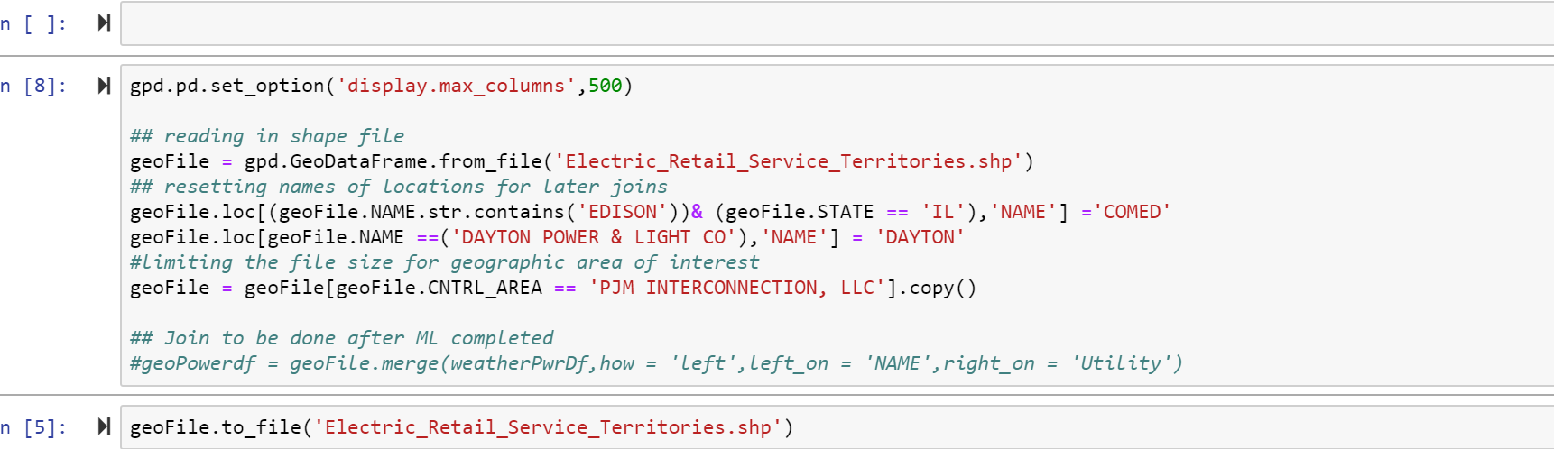
The Data

Slide 9
Data Viz - Tableau

Slide 10
The Model
Linear Regression Model
Train/Test/Split method
Removed outliers
Final Model
16 models in total
Models for each Year and City
Above/Below 60 degrees

Slide 11
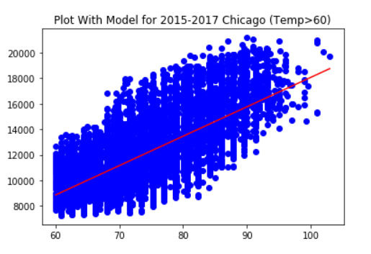
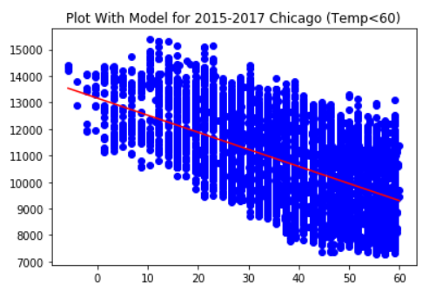
The Model - Chicago

Slide 12
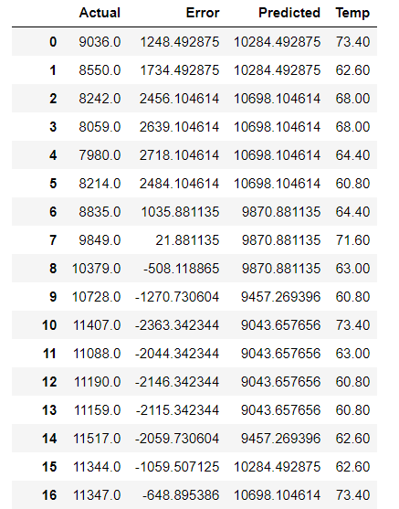
The Model - Chicago

Slide 13
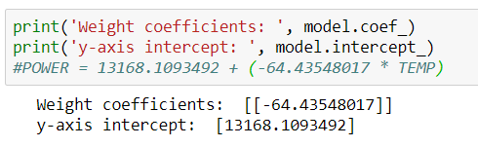
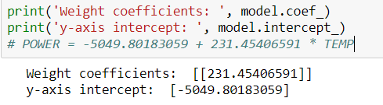
The Model - Chicago
Below 60
Above 60

Slide 14
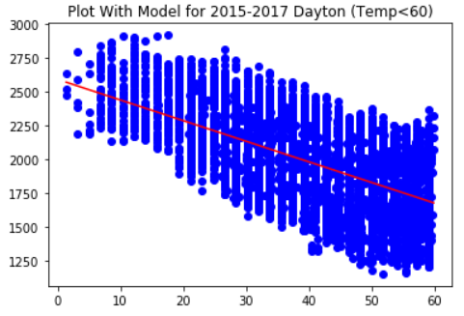
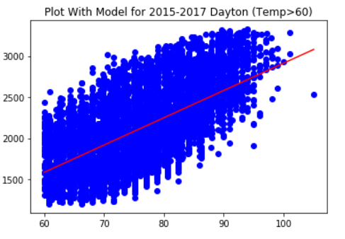
The Model - Dayton

Slide 15
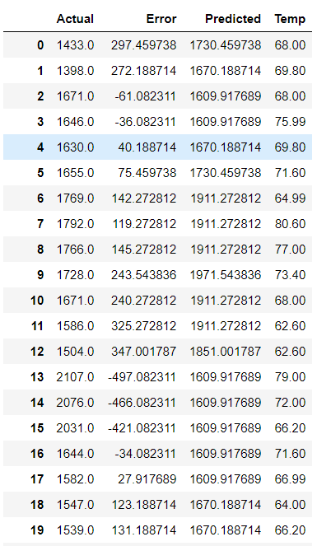
The Model - Dayton

Slide 16
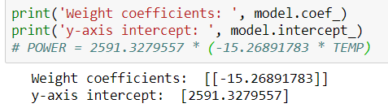
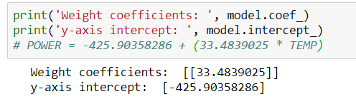
The Model - Dayton
Below 60
Above 60

Slide 17
The Model – Viz in Tableau

Slide 18
THANK YOU!
Q & A

